Slide 1


KESWICK
BI PROJECT PRESENTATION
BY DSA 3050

Slide 2
TABLE OF CONTENTS
01
02
03
KESWICK OVERVIEW
OUR VARIABLES
THE VISUALISATIONS
04
05
06
THE INSIGHTS
RECOMMENDA-TIONS
ANY QUESTIONS

Slide 3
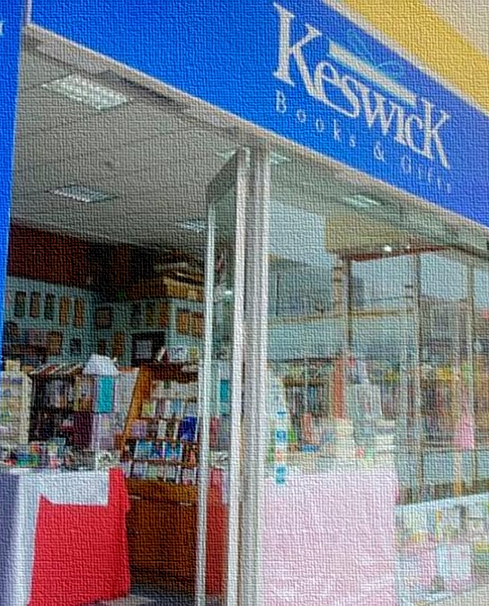
OUR
COMPANY
Keswick Books and Gifts Ltd.

Slide 4
ABOUT THE COMPANY
Keswick Books and Gifts Ltd. is a leading Kenya-based retailer focusing on Christian literature and religious products. Their product range includes a wide variety of Bibles, Christian books on topics such as theology, spirituality, Christian living, and devotionals, as well as educational books for children and young readers. The store also offers church supplies and faith-based gifts.
The company’s mission is to provide products that inspire, educate, and foster the spiritual growth of individuals and families.

Slide 5
This Project aims to first assess their BI maturity levels, to determine at which stage the business is in to base our strategy, approach, and recommendations on this information.
Secondly, to create visualizations in Power BI to ensure we help the business achieve its current business goal; expansion of its audience and platform.

Slide 6
BI MATURITY LEVEL
During our evaluation of Keswick's business intelligence (BI) maturity, we identified that the company is currently positioned in the Defined Stage of the Capability Maturity Model Integration (CMMI) framework. This suggests that Keswick's projects are effectively planned, executed, measured, and controlled. Our analysis and recommendations are aimed at guiding Keswick toward a higher level of BI maturity, i.e., the Managed Stage.

Slide 7
OUR VARIABLES

Slide 8

SIMULATED DATA AND STORE DATA
We were fortunate and extremely grateful for the data provided to us by the business. However, there were certain visualizations we were interested in seeing that couldn’t be fully fleshed out from the original data. Therefore we simulated some variables, namely:
Social Media Engagement
Sales per Bible Category per Branch
Sales trend in the year 2023
Expense type per Branch
Despite this challenge, we were able to utilize the customer_cohorts_v4_monthly_rollup_2023-10-01_2024-09-01.

Slide 9

VISUALISATIONS + INSIGHTS

Slide 10


Slide 11
SIMULATED VARIABLES
Social Media Engagement
Sales per Bible Category per Branch
Sales trend in the year 2023
Expense type per Branch
To show how engagement distribution across platforms is helpful in determining the most effective and lucrative platform for engagement.
To show what type of Bibles would be best to keep in stock for each location, hence focus on Location-specific stocking and Customer preferences.
Peaks and Drops throughout 2023.
This is important for getting a concrete understanding of low seasons and how to strategize and improve customer flow (through discounts & targeted ad campaigns)
Shows the expense cost per branch.
This helps in determining which expenses can be cut in which branches, i.e., lower-performing branches could have some of their expenditures reviewed and reduced.

Slide 13
ORIGINAL DATA VARAIBLES
Customer Lifetime Value
This measure helps us in understanding the customer retention rate of the business, hence a key element in the Analysis.
Calculated from the data in the Customer v4 Cohort Excel sheet,
it projects how frequently a customer comes back since their first order {goes down as customers return until eventually, they just dwindle out at 9+ times}.

Slide 14
SALES TREND ANALYSIS LINE CHART
Key Insights:
From the line graph in the year 2023, we can pull from it two peaks; April and October, with April being the highest at nearly 250K. Their lows, in turn are mid year (June and August, both at around 70K).
1

Slide 15
BRANCH EXPENDITURE COMPARISON
Key Insights:
CBD spends the most on salaries, Kilimani on maintenance, whereas Mombasa and Ngong Rd have a more balanced expenditure but focus on salaries. Nakuru spends a lot on salaries but the least on utilities.
This helps in determining expense cuts for certain branches, i.e., Rent contracts renegotiations and Salaries (assessing whether staffing levels align with each branch's performance and adjusting accordingly to balance costs, and boost productivity.}

Slide 16
BRANCH REVENUE COMPASRISON
Focusing on Branch-Specific Needs by increasing stock for Children’s Bibles at Ngong Road and Pocket Bibles at the CBD to match demand patterns keeps a happy, returning customer base and could potentially lead to growth due to clear evidence of a reliable business, attentive to their customers’ needs.

Slide 17
ENGAGEMENT RATE % PER PLATFORM DONUT CHART
Showing how engagement distribution across platforms is helpful in determining the most effective and lucrative platform for engagement.
Key Insights:
Instagram leads in engagement at 27.54%, followed by LinkedIn(25.05%) while Facebook and Twitter collectively account for less than 50% of the engagement.

Slide 18

CUSTOMER LIFETIME VALUE
As can be seen below, the data mostly concentrates on customer orders in the last quarter of the year 2023. Here, we see that First Orders wrack up the highest amount in orders at over $300K. However, as time goes on, returning customers dwindle, leaving the highest return period at 8 times since the first order, indicating a worrying trend; lack of customer retention. This may need some brainstorming from the managers of the business.

Slide 19

RECOMMEN- DATIONS

Slide 20


OUR RECOMMENDATIONS
DATA ANALYTICS TEAM
STORE EVENTS
On-board a Data Analytics Team to assist in analyzing your data.
In-store Bible Study Sessions & Christian Karaoke
WIDEN YOUR DATA TYPES
INCREASE PRODUCTS
Take example from the data we simulated.
Venture into contemporary romance or more Christian Lit.

Slide 21
THANKS!
1

Slide 22
ANY QUESTIONS?

